Slide 1
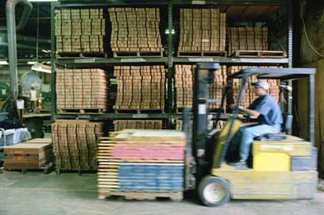



Retek Point of Service
Solution Overview
Retek’s Mission:
Help the Retail Industry Create, Manage and Fulfill Consumer Demand

Slide 2

Agenda
Why POS? Why now? Why acquire?
Retek Point of Service, what is it?
The technology, how does it work?
Case studies and business benefits

Slide 3
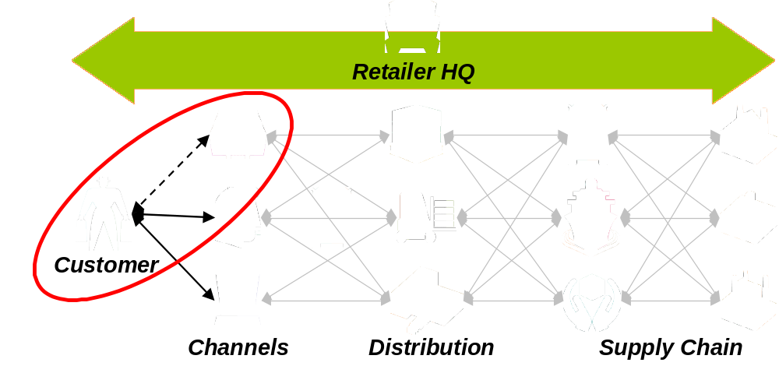
Customer Insight: Stores Matter Most
Stores are the primary point of consumer interaction
This channel of consumer distribution alone, accounts for over 90% of the retail economy.
(Source: U.S. Department of Commerce Census Bureau, 11/28/01)

Slide 4
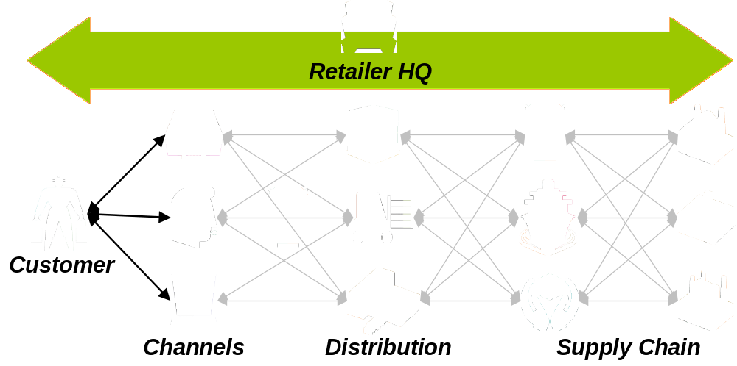
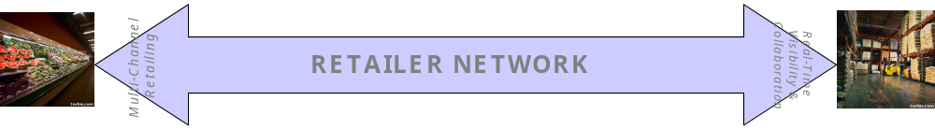
The Real Time Enterprise: Value Delivery

Slide 5
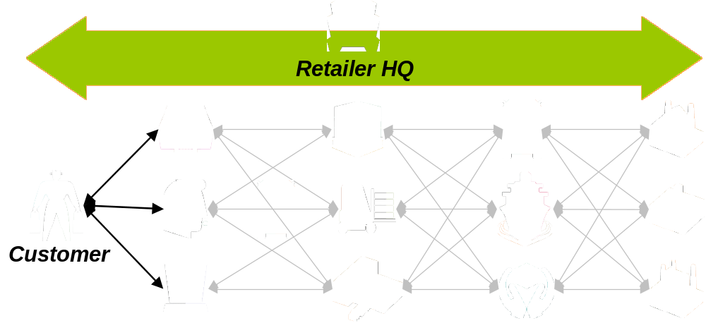
Execution: Delivering on the Brand
Integrated multi-channel front-end & back-end execution delivering a flawless customer experience
“Put the customer first, communicate, keep your ear to the ground, push responsibility and authority down, force ideas to bubble up, stay lean and fight bureaucracy.” (Sam Walton)

Slide 6
Store Technology has evolved
00’s
Dynamic interaction
The networked store
Platform independence
Wireless
90’s
More OS options
Platform variety
Better connectivity
Batched data
“Thinner” Client
80’s
“Iron” led
Propriety OS
Software GWP
Fixed checkout
Fat Client

Slide 7
Demand for “open” store systems
Retailers demand Options
  Hardware and software decisions to be made as independently of each other as possible
Easier Deployment
  The ability to configure rather than change code and to do that once. Centrally.
Flexibility
  Reuse of code in varied and multiple environments (E.g. acquisitions) and to aggressively exploit new selling opportunities
Dependability
  Unlike basic inventory management in the stores, POS is mission critical. It always need to work.

Slide 8

The “End Game” – Best Practices
Customer Relationship Management has merged the aims of customer service into actionable programs
Portable computing is penetrating the sales floor
RFID will revolutionize store operations and inventory control
Centralized management of key employee and inventory management functions
High bandwidth connectivity approaching dynamic pricing and promotions
Fully integrated store systems leveraging corporate resources

Slide 9

Build, Partner or Buy Decision
Build
  Quickly dismissed due to lack of POS expertise and time to market
Partner
  Viable candidates had overlapping back office initiatives with Retek.
Buy
  Narrow field of choice
  Primary Drivers:
    Proven (is in production)
    Scalable Architecture
    Little back office overlap

Slide 10
Agenda
Why POS? Why now? Why acquire?
Retek Point of Service, what is it?
The technology, how does it work?
Case studies and business benefits

Slide 11




Retek Point-of-Service
Handheld
JVM Client
Stores
Browser
Web Server
Labor Mgmt
POS
Customer
Inventory
RPOS
Applications
Time
&
Attend.
Schedule
Sale
&
Return
Layaway
Store &
Cash
Mgmt
Purchase
History
File
Maint.
Transfers
Merch.
Locator
Retek Point of Service
Common Business Objects
(Java Object Library)
Platform
Shared Services
(Examples)
Transfers
Tax
Sales Audit
Payments
Enterprise Application Integration (optional)
Back
Office
Customer
Revenue
Optimization
Order
Management
Merchandise
System
Data
Warehouse
Store
Replenish
Distribution
Management
HR and
Accounting

Slide 12
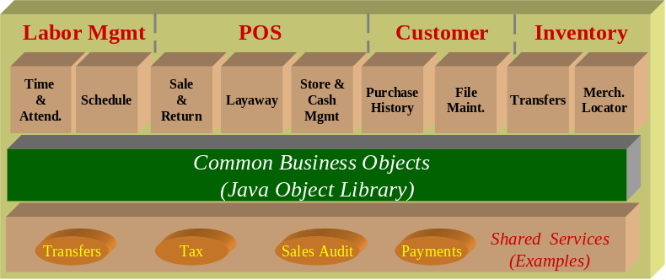
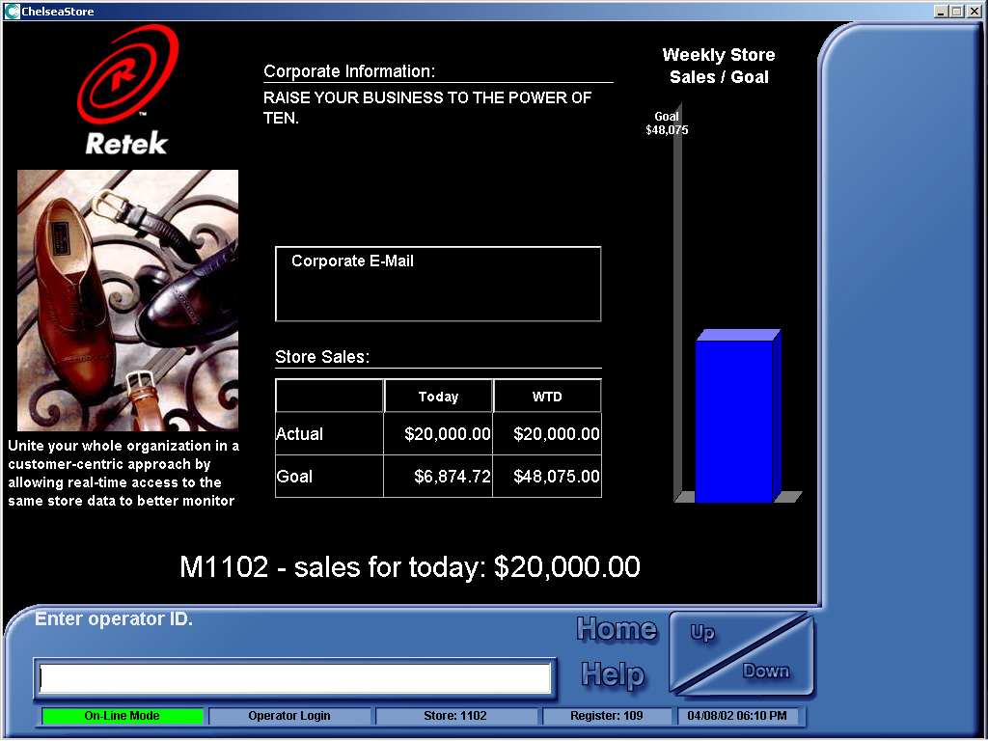
Point-of Sale/Sales & Return
Standard POS Features
  Unlimited Split Tendering
  Deal Pricing
  Tax Exempt Support
  Line item coupons
  Foreign tender support
  Gift cards and coupon
  Electronic signature capture
  Foreign Language support
  Item entry by SKU or Lookup

Slide 13
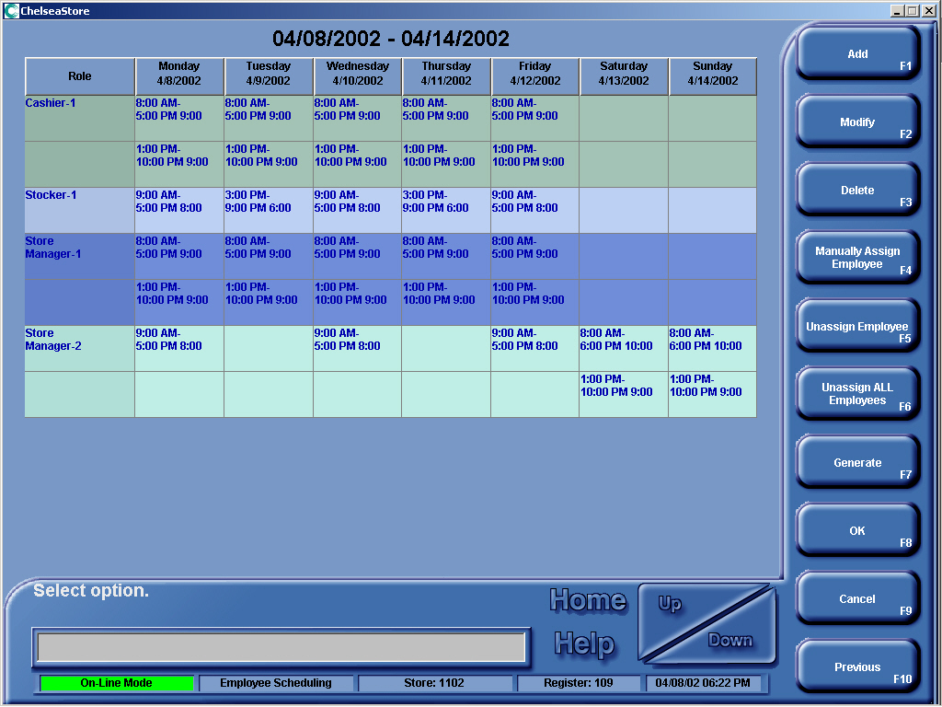
Point-of Sale/Layaway
Layaway Examples
  Find layaways by customer
  Find by phone
  Layaway
    Purchase
    Payment
    Adjustment
    Return

Slide 14
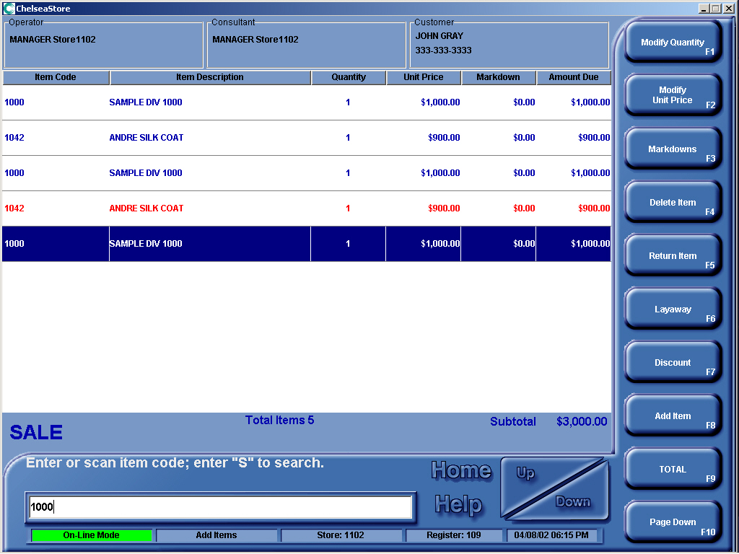
Point-of Sale/Store & Cash Management
Store & Cash Management
  Ad hoc reporting
  Employee goal setting and tracking
  Biometric security
  Adjust Start/end drawer fund
  Cash/Media entry
  Over/short report
  Bank Report
  Currency media support

Slide 15
Labor Management
Labor Management
  Time Card Management
  Clock in, clock out
  Time card reporting/auditing
Labor Scheduling
  Time off/vacation requests
  Assign schedule roles
  Assign optimal working hours
  Create and save schedule templates
  Auto generate weighted schedules
  Commit and print individual/store schedules

Slide 16
Customer and Inventory Management
Customer Management
  Customer Trans History
  File Maintenance
  Chain wide availability of info
  Language Preference
Inventory Management
  Inter-store inventory transfer in/out
  View pending transfers and detail
  Merchandise Locator
  Merchandise on-hand/sales by item SKU report

Slide 17
RPOS Platform – Java Object Library
Flexible network topology
  Real-time, trickle, or batch
  In-store processor is optional
  Hardware independent
Complete location transparency
  Location of data or service is based on business requirements, not technical limitations
Supports browser and applications
Synchronous or asynchronous messaging

Slide 18
Agenda
Why POS? Why now? Why acquire?
Retek Point of Service, what is it?
The technology, how does it work?
Case studies and business benefits

Slide 19
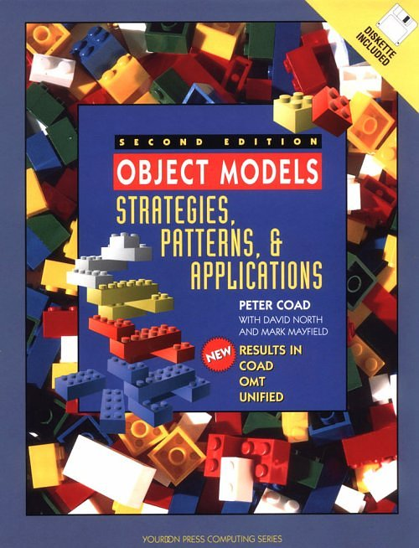
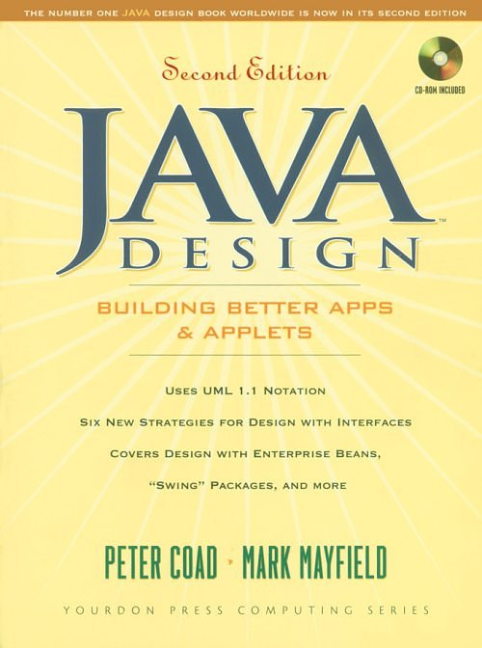
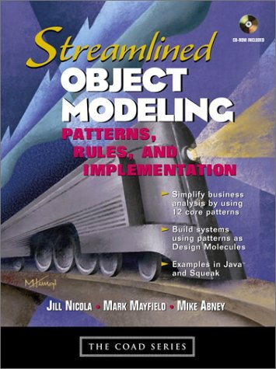
Retek Object-Oriented Expertise
Key Retek RPOS development managers have authored several books on object-oriented development.
  Object Models: Strategies, Patterns, and Applications (Mayfield)
  Java Design: Building Better Apps and Applets (Mayfield)
  Streamlined Object Modeling: Pattern, Rules, and Implementations (Mayfield and Abney)

Slide 20
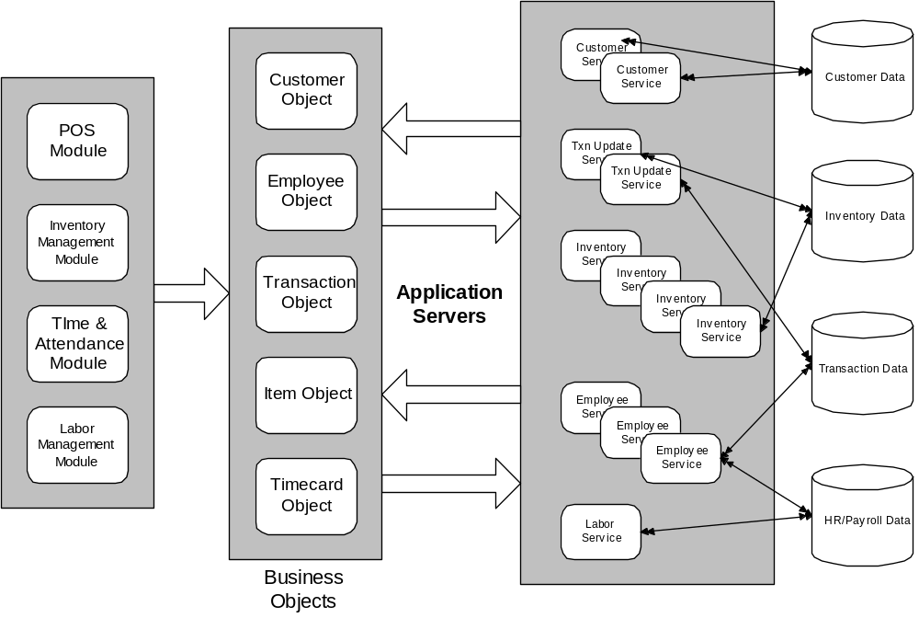
Common Objects Across Multiple Applications

Slide 21
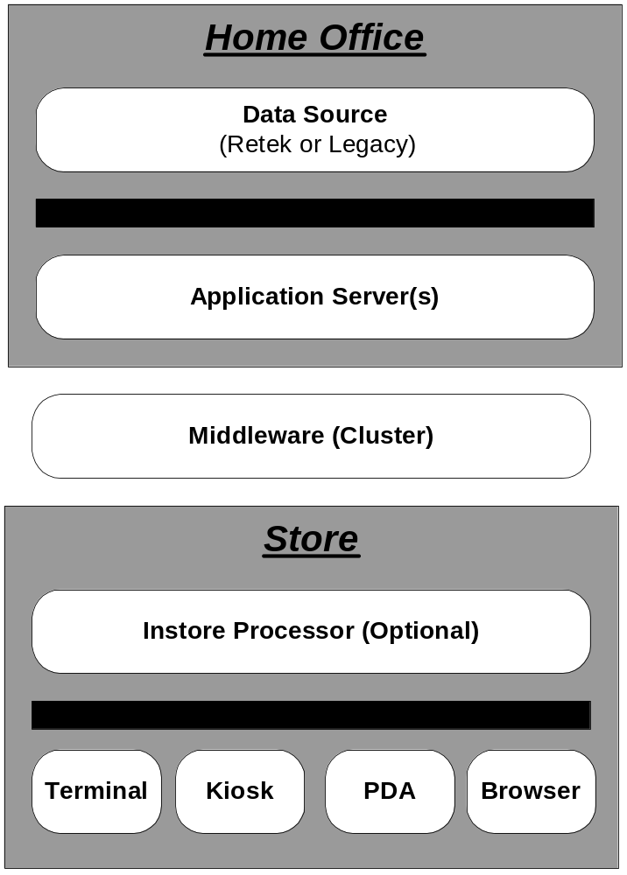
What is it? “Architecture”
Database independent. IBM, Oracle, Microsoft
J2EE
Assures Fault tolerance of the system by directing client requests to application servers and performs load balancing
Application can run as “Fat” and as “Thin” as the retailer desires
RPOS is device agnostic. The same object model, business logic and application management is applied to each device.

Slide 22
Platform Scalability
Key to scalability is physical distribution and prove linear scalability
Scalability test perform at IBM labs in Austin
  Scenario 1
    1 IBM B80 – 4 CPU’s 300 mhz, 1 gig memory
  Scenario 2
    2 IBM B80 – 4 CPU’s 300 mhz, 1 gig memory
Increase in throughput of 99.18%
  Scenario 3
    2 – 4 CPU’s 1100 mhz, 1gig memory

Slide 23
Software and Retail Standards
ARTS
IXRetail
UPOS/JPOS
J2EE
Java API (according to Sun)
XML
JMS

Slide 24
Network-centric Approach
Peer-to-peer communication between clients increases performance and throughput
Minimizes use of slow networks, maximizes use of the fast networks
Operates without a network and automatically detects when a network is available
Operates on several network types:
  WANs, including T1, 56k Frame Relay, DSL, and so on
  LANs, including 802.11 and 10/100 Ethernet

Slide 25
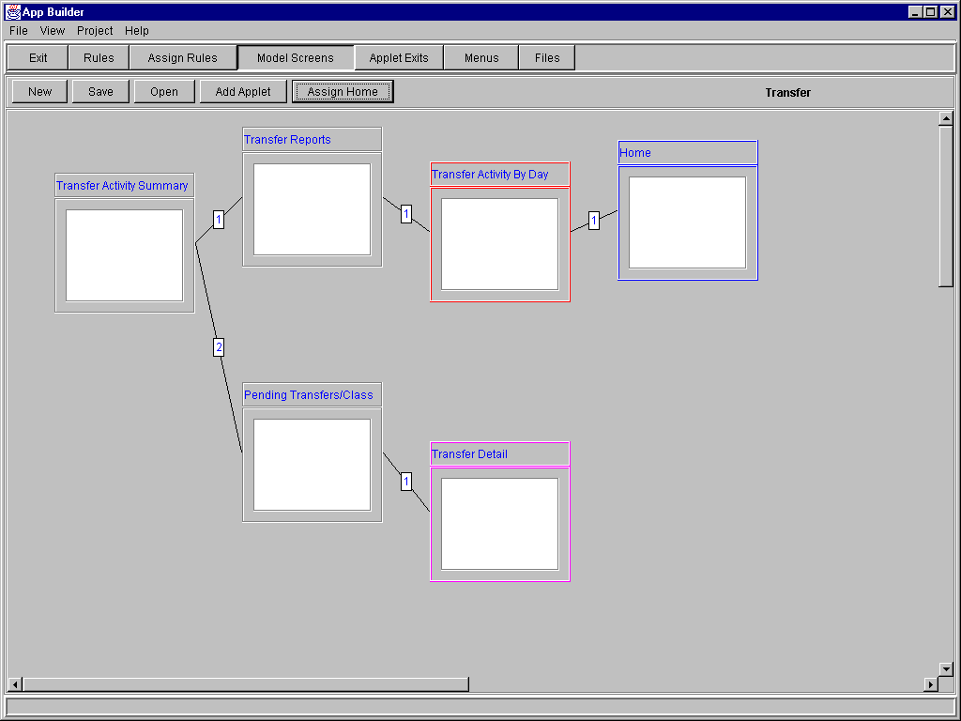
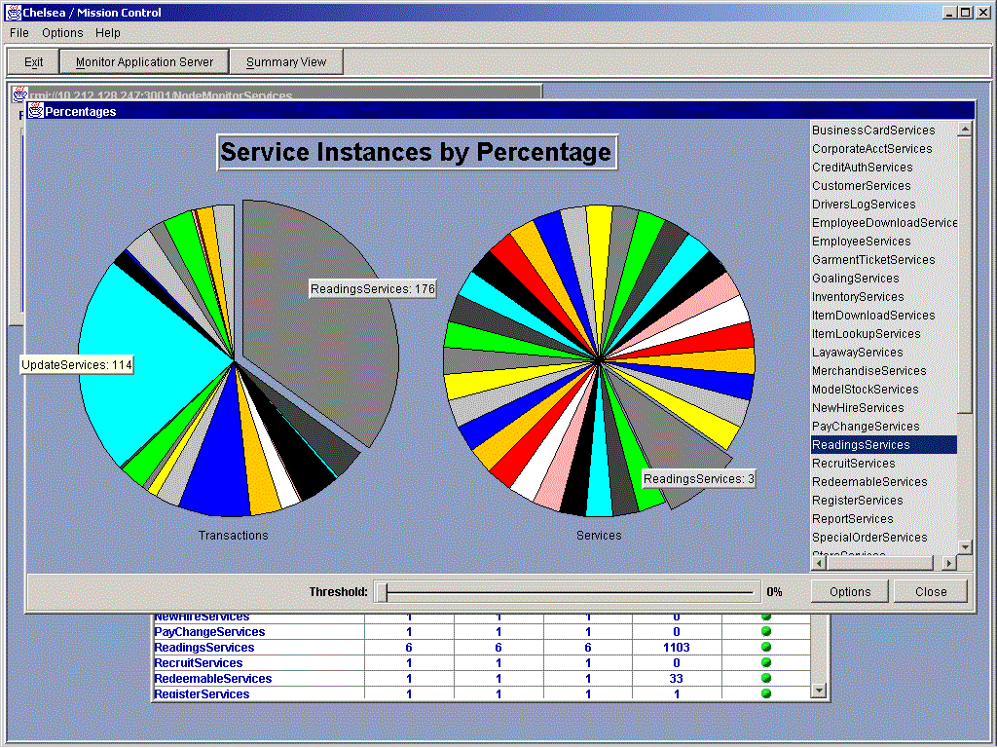
Developer and Network Tools
Application Builder – a rapid development tool that allows business analysts to customize RPOS
Mission Control – a monitoring and performance-tuning tool that allows system administrators to dynamically manage performance at any local or remote location.

Slide 26
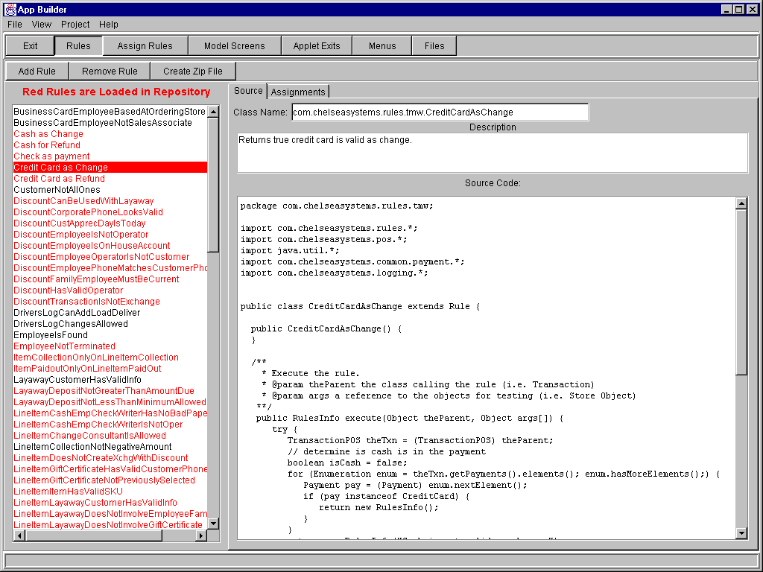
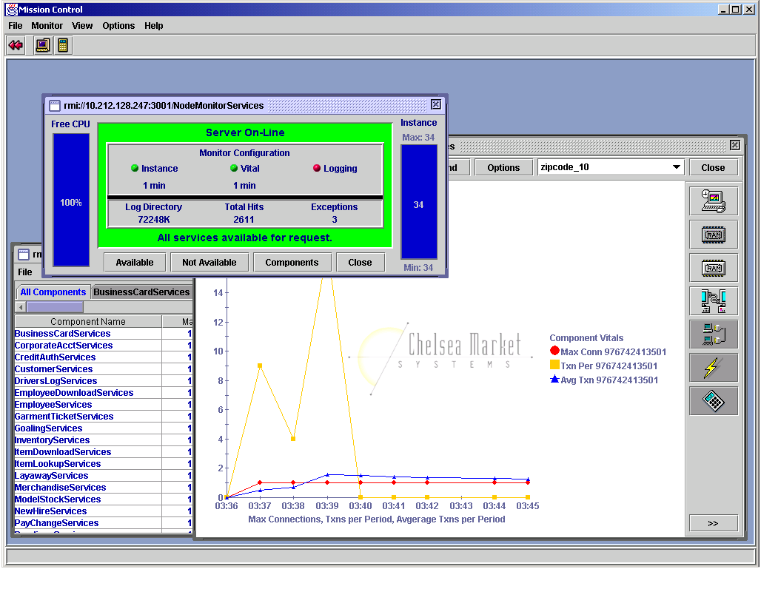
Developer and Network Tools
Receipt & Report Builder – business analysts can use this sophisticated graphical tool to build transaction receipts or report printouts.
Object Inspector - developers and help desk personnel can use this tool to diagnose and correct problems with various kinds of transaction objects.

Slide 27
Agenda
Why POS? Why now? Why acquire?
Retek Point of Service, what is it?
The technology, how does it work?
Case studies and business benefits

Slide 28

Worlds first successful deployment of Java POS
Live and in production for two years
500+ stores with over 5000 devices
Details
Full Real Time (centrally deployed)
Run Dell (PC) Celeron 500Mhz, 128m memory
Windows 2000
Solaris Application Servers
Universe Database DG/UX
Benefits
Cut training time by 50%
Reduced IT maintenance costs Improved speed of checkout
Increased revenue by “saving a sale” feature.
Improved corporate communication and sales expectations.

Slide 29

In Production and rolling out to 400 stores
First Java POS on Linux
4.5 months to deploy
Details
Full Real Time (centrally deployed)
IBM SurePOS 600
Linux (Red hat) client OS
Linux application servers
AS/400 database (DB2 400)
Benefits
Cut Implementation and deployment cost in half.
Complete elimination of data integrity issues
New store formats will be accelerated due to flexible technology.

Slide 30

In Production and rolling out to over 900 stores
Over 5000 devices
1.5 months to deploy (Labor Management)
Details
Real time for labor
Integrated to Peoplesoft
Current approach: ISP for POS
Dell PC’s (Workstation Today)
Windows 2000 (XP considered)
AIX Application servers
IBM Mainframe Database
Benefits
-Lower hardware cost
-Reduced time entry errors, fraud and manual processes
-Reduce labor costs and improve overall in-store conversion.
-Increase sales with “save-a-sale,” real time inventory visibility

Slide 31


RPOS and TMW being showcased
“What’s in Store: Retailers are bringing the clicks to the bricks”
Wall Street Journal, 7/15/02
“Using Technology to get ahead in business”
Newsweek, 4/29/02

Slide 32
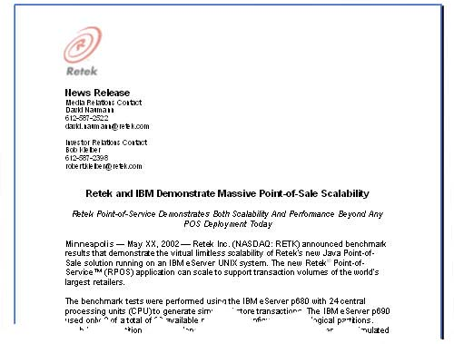
Retek Point of Service
Shatter the Total Cost of Ownership economics in the store, create a new breed of Customer Experience based applications, and enable a Real-Time retail supply chain.
Mission Critical
Functionality
Scalability
RPOS delivers a next generation store solution and slashes Total Cost of Ownership by over 50%

